Slide 1
Social Networking Safety & Security

Slide 2
Classroom Etiquette
Please turn off all cell phones
Leave food & drink outside
Water bottles are okay
“Respect/ help” your neighbor
Direct questions to the instructor
Request special needs at the beginning of class

Slide 3
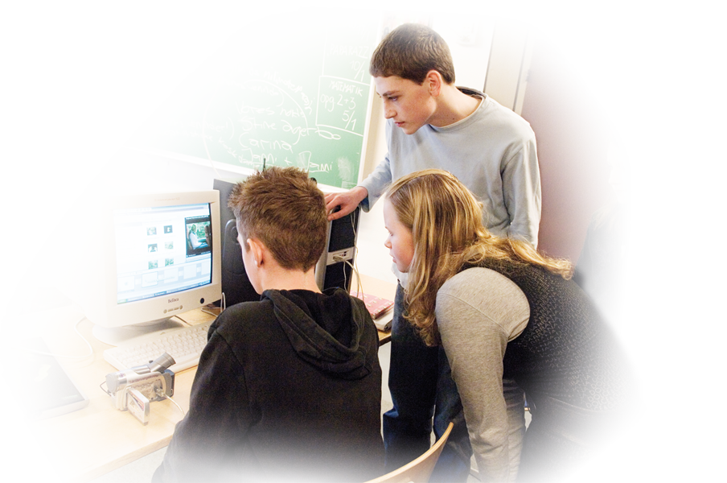
Overview:
Social networks
Privacy settings
Once online, always online
Anti-Malware/Anti-Virus Software

Slide 4
Learning Objectives
Consider future implications of material posted online
Evaluate current privacy settings to determine if they are in alignment with your definition of privacy

Slide 5
What is Social Networking
A website that is used to communicate with others by posting messages, sharing information, and sharing photos.
Common components
Messaging system
Friends list
Profile
Photo sharing

Slide 6
Where is your personal information?
Facebook
Twitter
Google Plus
Foursquare
LinkedIn
Pinterest

Slide 7
Social networking Vocabulary Sheet

Slide 8
Sharing
What info are you sharing
Phone numbers
Birthdays
Maiden names
Pet names
What can be done with this info?
Online is like a room full of strangers

Slide 9
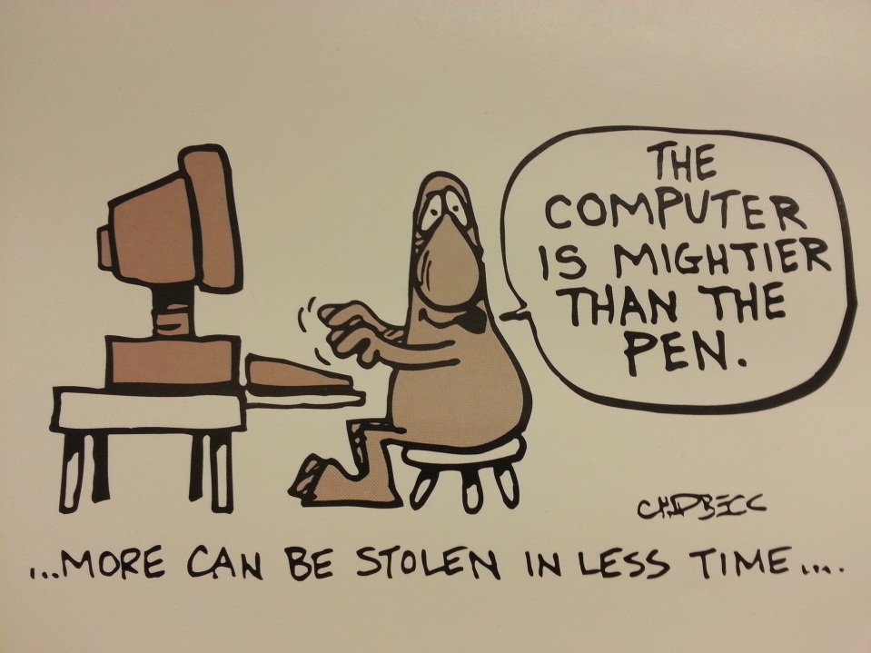
Sharing
Identity theft
Used to go though mail and garbage looking for personal information
Now they have moved their search online
Google self audit
Search for your name example

Slide 10
Location Services
Your location is shared in many places
Photos (geotagging)
Messaging (Facebook automatically does this)
Status updates (location tagged)

Slide 11
Profiling
Automatic location check-ins (Facebook, Twitter, and Foursquare)
Status updates about work or daily activities
Pictures from daily activities

Slide 12
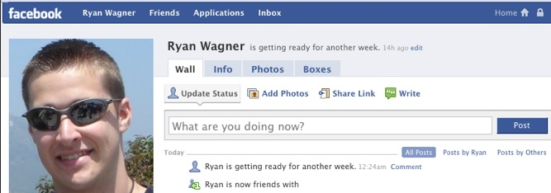
Public Forum
Would you post this information
On a billboard
On your front door
Consider what you post
You are the first line of defense
Treat privacy settings as secondary line of defense
Facebook is the friend that can’t keep secrets

Slide 13
Interactive Activity: Info Hunt
Part 1 – The Attacker
In this activity you will be playing the role of an attacker. However, instead of using technical skills, all you will be using are the social networking pages of the targets. Your goal is to acquire as much potentially useful information as possible.
You will be given handouts of portions of each target’s profile page as well as a worksheet with questions to help guide you.
Feel free to discuss with others at your table about what information could be valuable.

Slide 14
Interactive Activity: Info Hunt
Part 2 – The Employer
In this activity you will be playing the role of an employer looking to fill a position with one of three applicants.
Over half of employers now check social networking profiles of applicants before making their decisions.
You will be given handouts of portions of each applicant’s profile page. Discuss which person you would be most likely to hire.

Slide 15
You Can’t Take That Back
Once online, always online
Others can share it
Others can copy it
Wayback Machine
Takes snapshots of most public websites
Similar to microfilm archives at libraries

Slide 16
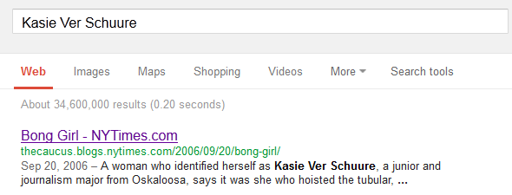
Bong Girl
Kasie Ver Schuure
Offered John Kerry a drink on her 21st Birthday
Occurred in 2006
NY Times “Bong Girl” article is on the first page on Google search under her name: http://tinyurl.com/aca4f6z

Slide 17
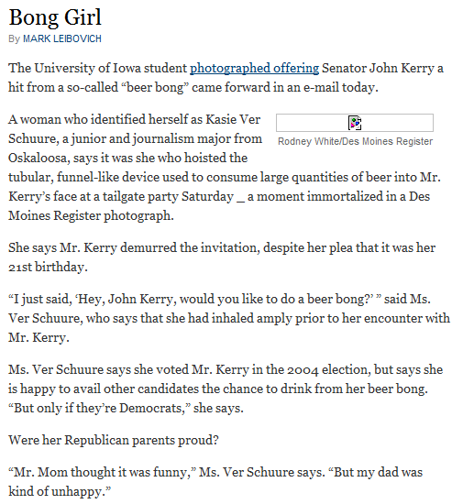
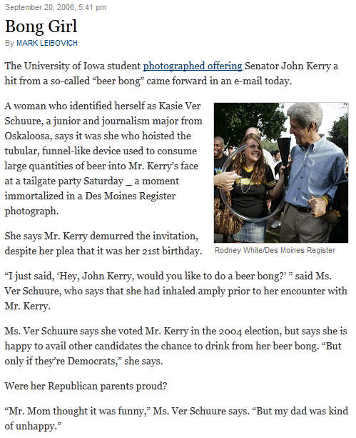
Bong Girl

Slide 18
Facebook Photos
Accessible without being logged in.
Privacy settings don’t matter if the web address is known.
https://sphotos-b.Xx.fbcdn.net/hphotos-snc7/457558_10100676970752150_676393542_n.jpg

Slide 19
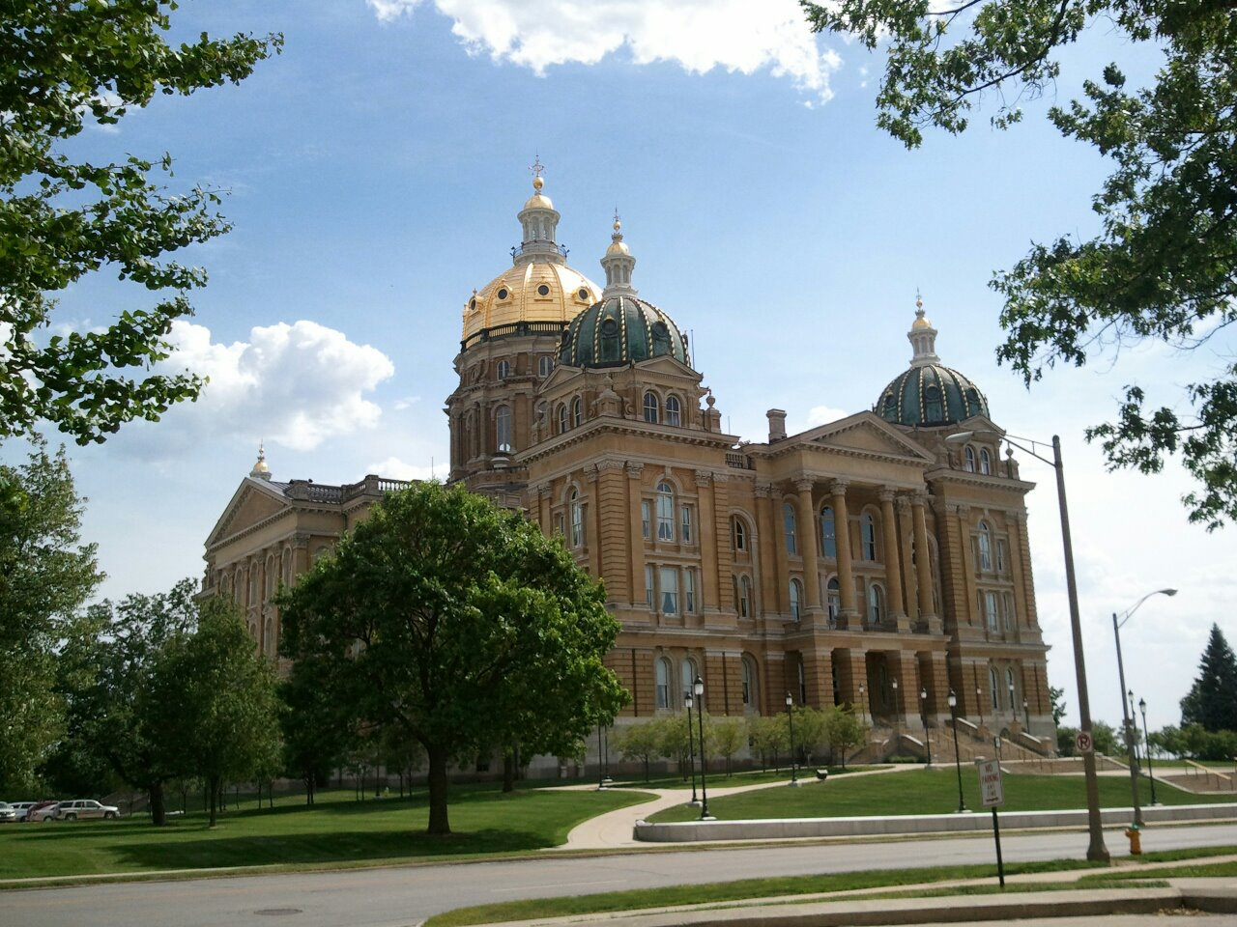
Facebook Photos

Slide 20
Facebook Location Settings
Facebook posts may automatically attach location information
Tagging friends also identifies their location
Have ability to require approving tagged posts

Slide 21
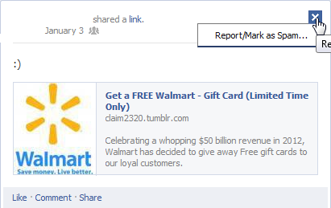
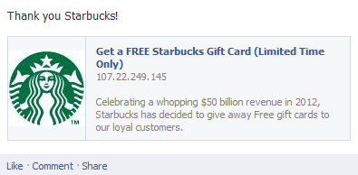
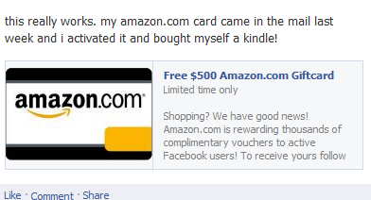
Social Networking Phishing
Emails about password changes
Fake contests
Free iPad!
Free Gift Card!

Slide 22
Don’t Reuse Information
Use a unique password for each website/service
Sites may be vulnerable to attacks
LinkedIn breach
6.46 million passwords leaked
Security question answers should be difficult to guess
Consider using fake answers
Those same security questions may be the same you use for banking
Consider using Password Manager

Slide 23
Anti-Malware Software
Many programs available both free and paid
Beware of scam anti-virus software and popups
http://windows.microsoft.com/en-us/windows/antivirus-partners#AVtabs=win10

Slide 24
Fake Anti-Malware

Slide 25
Patching
Ensure your programs are up to date
Web Browsers
Firefox/Chrome/IE
Plugins
Flash, Java,etc
Windows/MAC Software Updates
Installed Programs
Consider Ninite

Slide 26
Privacy Policy
Many larger websites have privacy policies
Most are very long and have complicated language
States what the website/company will/can do with your data

Slide 27
Link Security
http://www.learningaboutthe.net/phishing/phishing.php

Slide 28
Recap
Consider what you post online before posting it
Review past posts
Review your privacy settings
Do not reuse login information between sites
All of our handouts and this presentation will be on our website at www.learningaboutthe.net

Slide 29
Questions
What questions do you have for us?
All materials available online at:
www.learningaboutthe.net

