Slide 1
Mobile device security

Slide 2
Learning Objectives
Evaluate an application’s permissions and its implications to personal data.
Consider device protection mechanisms and the security features offered by each
Identify methods to properly remove sensitive data from a device
Consider the implications of the loss/theft of a device and formulate a recovery plan

Slide 3
Outline
Introduction to Mobile Devices
Applications and their Permissions
Staying safe from malware and viruses
Removing personal data from mobile device

Slide 4
What is a Mobile Device?
What do you think the definition of a mobile device is?
A mobile device is a tablet or smartphone with high computing power and combines multiple features into one device.
Some features may include: Web browser, GPS, camera, touchscreens, media players, and other applications

Slide 5
Operating Systems
An operating system is a collection of software that manages computer hardware.
What operating system does your device have?

Slide 6
Operating Systems
65.37% Android
19.61% iOS
2.22% Windows Phone
1.01% BlackBerry OS

Slide 7
Features of Mobile Devices
Applications – pieces of software installed onto the device for altering the device capabilities
Adding games and other features
Child locks: preventing certain actions from being performed
Settings – options to tell the device how you want it to look, sound, and act

Slide 8
What Are Some Categories You Can Think of For Mobile Applications?
Games – Angry Birds, Farmville, Tetris
Entertainment – Hulu Plus, Netflix, Pandora, Spotify
Social Networking – Facebook, Twitter, SnapChat
Business – Gmail, Mobile Banking, Excel, Word
Navigation and Nearby Attractions – Google Maps, Yelp
Security – SeekDroid, Lookout Mobile Security

Slide 9
Where to Get Apps?
In most cases, you should only trust the official app store for the mobile device you use.
Apple – Apple Store
Android – Play Store
Kindle – Amazon Apps
These stores typically have a screening process for their applications to help reduce the number of malicious applications in the store.
Third party websites may not screen their applications and may purposely be distributing malicious applications.

Slide 10
Know What You Are Downloading
Free vs. Paid applications
Hidden fees
In-app purchases e.g. Draw Something, Angry Birds Space
Paying to unlock features
“Trial” versions
Application Permissions
What am I allowing this application to do?

Slide 11
Application Permissions
An application permission is a statement telling you what this particular application requests access to.
However, malicious developers could require more permissions than necessary.
There are 12 main categories of permissions:
Calendar
Camera
Contacts
Location
Microphone
Phone
Body Sensors
SMS
Storage
Device & App History
Identity
Other

Slide 12
Which One Would You Choose?

Slide 13
YOUR ACCOUNTS
Create Accounts And Set Passwords
Add Or Remove Accounts
HARDWARE CONTROLS
Take Pictures And Videos
YOUR LOCATION
Approximate Location (Network-based)
Precise Location (GPS And Network-based)
NETWORK COMMUNICATION
Full Network Access
YOUR PERSONAL INFORMATION
Read Your Contacts
MODIFY YOUR CONTACTS
PHONE CALLS
Read Phone Status And Identity
STORAGE
Modify Or Delete The Contents Of Your Usb Storage Modify Or Delete The Contents Of Your Sd Card
SYSTEM TOOLS
Prevent Tablet From Sleeping Prevent Phone From Sleeping
TOGGLE SYNC ON AND OFF

Slide 14
Facebook – Location Permissions
Approximate Location (Network-based)
Allows the app to get your approximate location. This location is derived by location services using network location sources such as cell towers and Wi-Fi. These location services must be turned on and available to your device for the app to use them. Apps may use this to determine approximately where you are.
Precise Location (GPS And Network-based)
Allows the app to get your precise location using the Global Positioning System (GPS) or network location sources such as cell towers and Wi-Fi. These location services must be turned on and available to your device for the app to use them. Apps may use this to determine where you are, and may consume additional battery power.

Slide 15
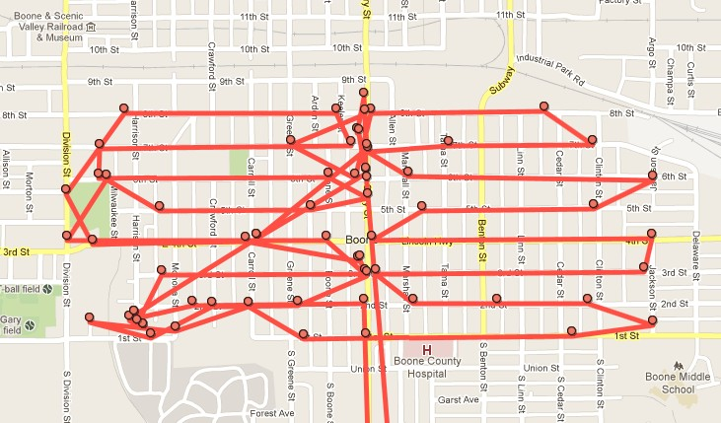
Location Information- Google Latitude

Slide 16
Facebook – Personal Information
READ YOUR CONTACTS
Allows the app to read data about your contacts stored on your tablet, including the frequency with which you've called, emailed, or communicated in other ways with specific individuals. This permission allows apps to save your contact data, and malicious apps may share contact data without your knowledge. Allows the app to read data about your contacts stored on your phone, including the frequency with which you've called, emailed, or communicated in other ways with specific individuals. This permission allows apps to save your contact data, and malicious apps may share contact data without your knowledge.
MODIFY YOUR CONTACTS
Allows the app to modify the data about your contacts stored on your tablet, including the frequency with which you've called, emailed, or communicated in other ways with specific contacts. This permission allows apps to delete contact data. Allows the app to modify the data about your contacts stored on your phone, including the frequency with which you've called, emailed, or communicated in other ways with specific contacts. This permission allows apps to delete contact data.

Slide 17
Which One Would You Choose?
We will show you three different applications from the Android market and their permissions.
Your job is to pick the application you would install on your phone out of the three based on the discussion we had about Android applications and their permissions.
Note: there may not be a “ideal” answer. The purpose of the activity is to choose one and justify your reasoning.

Slide 18
Which Game Would You Choose?
Scenario:
You are visiting with your family over Thanksgiving dinner and one of your younger relatives wants to play games on your phone. Since you normally don’t use your phone to play games, you need to quickly find an application from the Google Play Store to keep your relative occupied.
On your handouts, we have 3 selected games from the Google Play store.
Questions:
What application did each group install?
Why did you choose that application over the others?

Slide 19
Which Music App Would You Choose?
Scenario:
You have decided you want to get rid of your mp3 player and use your phone to listen to music instead.
On your handouts, we have a selection of music apps from Google Play.
Questions:
What application did each group install?
Why did you choose that application over the others?

Slide 20
Which Would You Choose? Recap
Ask yourself “Do I feel comfortable with letting an application have access to this?”
Review permissions before clicking “Accept & Download”.
For example:
Are you comfortable letting the iHeart Radio application know your exact location?

Slide 21
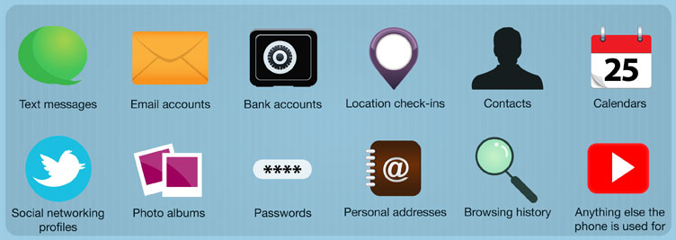
Data Stored on Mobile Device
Who has access to the information on your device?
What information could someone get from the device?

Slide 22
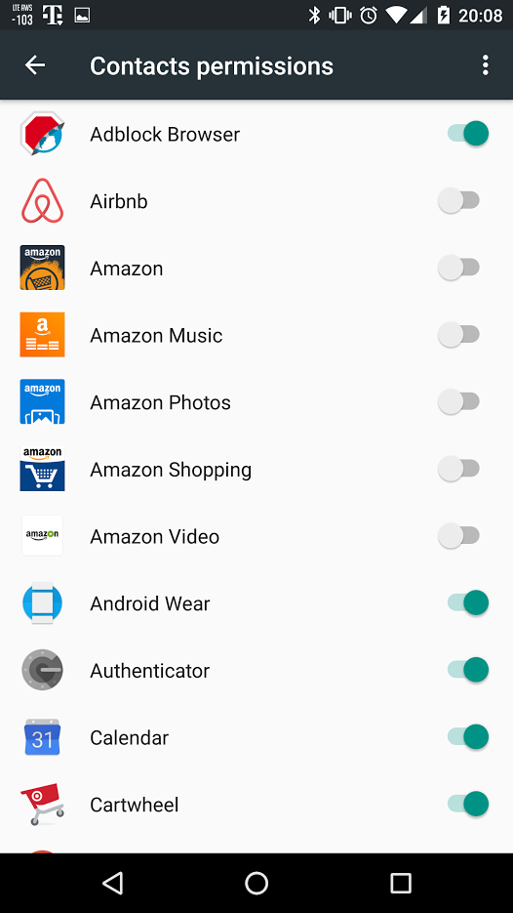
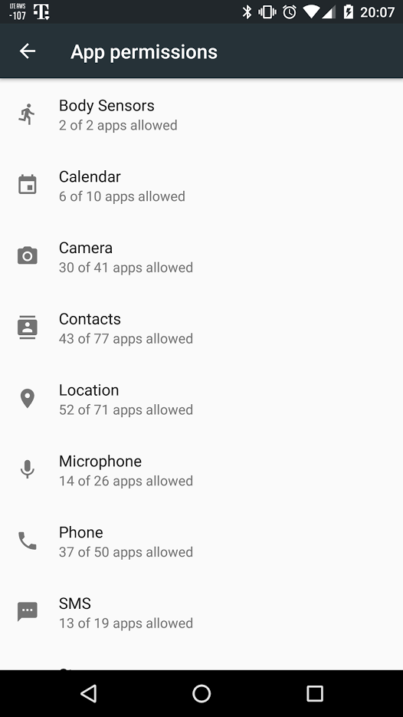
Consider Already Installed Apps

Slide 23
Apple ios permissions
Settings > Privacy > Location Services
Settings > Individual App

Slide 24
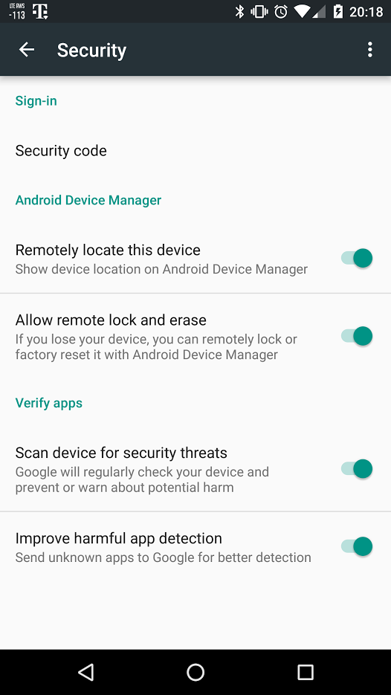
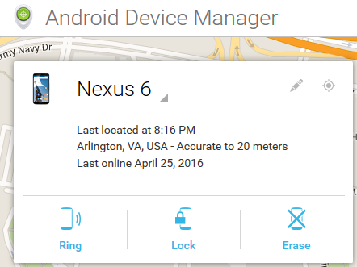
Physical Security
Android Device Manager
Built into Android Phones
Free
Allows for remote locate, ring, lock, and erase

Slide 25
Physical Security
Apple iCloud
Free application
Backup and Restore
Find My iPhone
Play sound if the device is lost
Remotely wipe data

Slide 26
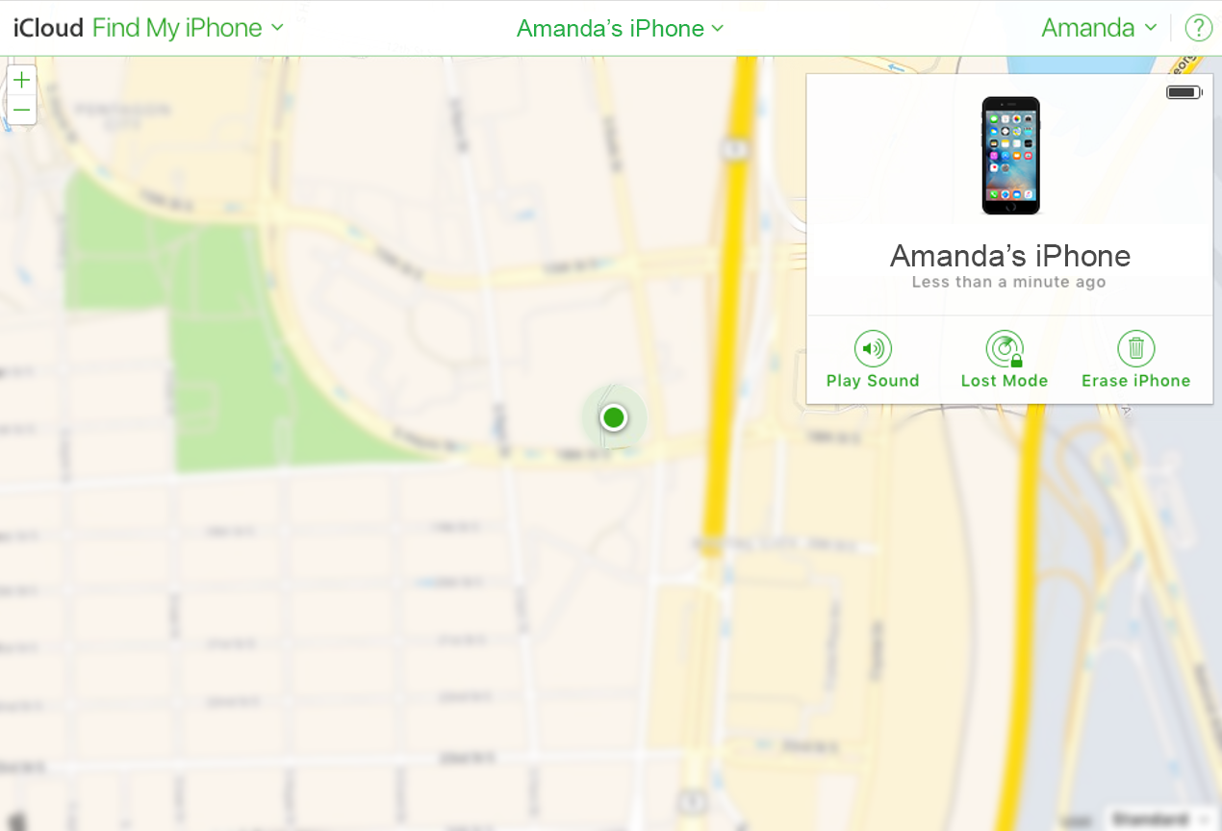
icloud.com Find my iPhone

Slide 27
Phone Locking
Swipe Pattern (Medium security)
Create a unique pattern on 3x3 grid
Can be detected via smudge attack
PIN (Medium to high security)
Number only password
Less possible combinations, easier to guess password

Slide 28
Phone Locking
Fingerprint (Medium to high security)
Unique feature to you
Others could enroll their fingerprints
Password (High security)
Password to unlock phone with numbers and letters
More combinations than a PIN password

Slide 29
Considerations While Using Wi-Fi
Public Wi-Fi connections
Often not encrypted
Example: DC Public Library
Could be a malicious Wi-Fi router
Anyone could be listening
Similar to having a public conversation
Auto connecting
Applications offer to auto connect to known free Wi-Fi spots
XfinityWifi
Starbucks
Traffic could be monitored and recorded

Slide 30
Protecting Your device
Why is it important to keep your device and applications up to date?
Software vulnerabilities could pose security problems
The applications may have new functionality.
Encrypting your device
Definition: Encoding data to make it difficult to read
Protect your data
Organizational Policy
John Smith
4716936665585065
Encryption
U2FsdGVkX1+rdVK5mLigl0dX28khw4XD+yaKGbFeXjbzAlW5kYup5PSuuroq8Sgo

Slide 31
Wiping Your device
When selling or replacing your device, you will want to get rid of any data on the mobile device storage to keep your passwords and personal information safe.
Every device has a proper procedure to delete the information on it.
We have gathered this information and put it on the handouts for you to use in the future.

Slide 32
Conclusion
Think before downloading:
Ask yourself “Do I feel comfortable with letting an application have access to this?”
Viruses & malware exist on mobile devices too!
Antivirus Application: Lookout
Plan ahead for if your device is lost or stolen:
Android Device Manager, iCloud
Protect your information:
Know how to properly wipe and erase data on your device
All of our handouts and this presentation will be on our website at www.learningaboutthe.net

Slide 33
Questions
What questions do you have for us?
All materials available online at:
www.learningaboutthe.net

